Slide 1
Identifying resources on the web
IN712 Web 3

Slide 2
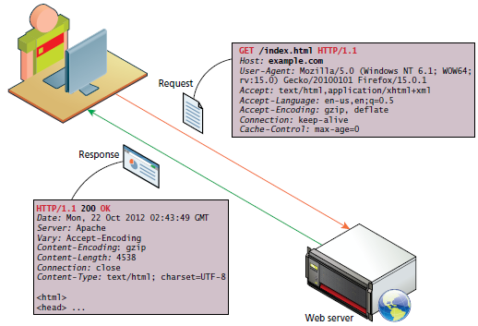
Introduction
The target of an HTTP request is called a "resource", which nature isn't defined further; it can be a document, a photo, or anything else. Each resource is identified by a Uniform Resource Identifier (URI) used throughout HTTP for identifying resources.
The identity and the location of resources on the Web are mostly given by a single URL (Uniform Resource Locator, a kind of URI).
http://www.example.com:80/path/to/myfile.html
Notes:
Exceptionally, there are sometimes reasons identity and location are not given by the same URI: HTTP uses a specific HTTP header, Alt-Svc when the resource requested wants the client to access it at another location

Slide 3
URNs (Uniform Resource Names)
A URN is a type of URI that identifies a resource by name in a particular namespace.
urn:isbn:9780141036144
urn:ietf:rfc:7230
Those two URNs correspond to
the book Nineteen Eighty-Four by George Orwell,
the IETF specification 7230, Hypertext Transfer Protocol (HTTP/1.1): Message Syntax and Routing.

Slide 4
URL (Uniform Resource Locator )
A URL is the most common type of URI, and is also known as the web address
https://developer.mozilla.org
https://developer.mozilla.org/en-US/docs/Learn/
https://developer.mozilla.org/en-US/search?q=URL
Any of those URLs can be typed into your browser's address bar to tell it to load the associated page (resource)
A URL is composed of different parts, some mandatory and others are optional. A more complex example might look like this:
http://www.example.com:80/path/to/myfile.html?key1=value1&key2=value2#SomewhereInTheDocument

Slide 5

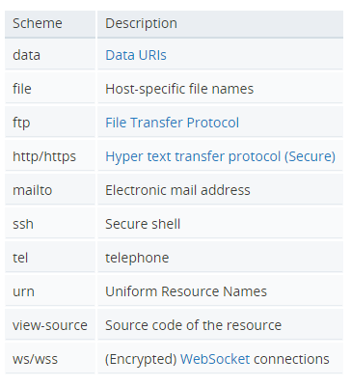
Syntax of Uniform Resource Identifiers (URIs) Scheme or protocol
http://www.example.com:80/path/to/myfile.html?key1=value1&key2=value2#SomewhereInTheDocument
http:// is the protocol. It indicates which protocol the browser must use. Usually it is the HTTP protocol or its secure version, HTTPS.
The Web requires one of these two, but browsers also know how to handle other protocols such as mailto: (to open a mail client) or ftp: to handle file transfer, so don't be surprised if you see such protocols.

Slide 6

Syntax of Uniform Resource Identifiers (URIs) Domain name
http://www.example.com:80/path/to/myfile.html?key1=value1&key2=value2#SomewhereInTheDocument
www.example.com is the domain name or authority that governs the namespace. It indicates which Web server is being requested.
Alternatively, it is possible to directly use an IP address, but because it is less convenient, it is not often used on the Web.

Slide 7

Syntax of Uniform Resource Identifiers (URIs) Port
http://www.example.com:80/path/to/myfile.html?key1=value1&key2=value2#SomewhereInTheDocument
A port is an endpoint of communication in an operating system.
The term is also used for female connectors on hardware devices (see computer port)
In software it is a logical construct that identifies a specific process or a type of network service.
A port is always associated with an IP address of a host and the protocol type of the communication, and thus completes the destination or origination network address of a communication session.
Specific port numbers are often used to identify specific services.
1024 well-known port numbers are reserved by convention to identify specific service types on a host.
After initial communication binds to the well-known port number, this port is freed by switching each instance of service requests to a dedicated, connection-specific port number, so that additional clients can be serviced.
The protocols that primarily use ports are the transport layer protocols, such as the Transmission Control Protocol (TCP) and the User Datagram Protocol (UDP).
It is usually omitted if the web server uses the standard ports of the HTTP protocol (80 for HTTP and 443 for HTTPS) to grant access to its resources.

Slide 8

Syntax of Uniform Resource Identifiers (URIs) Path
http://www.example.com:80/path/to/myfile.html?key1=value1&key2=value2#SomewhereInTheDocument
/path/to/myfile.html is the path to the resource on the Web server.
In the early days of the Web, a path like this represented a physical file location on the Web server
Nowadays, it can be an abstraction handled by Web servers to create structure for the web application without a map to physical reality

Slide 9

Syntax of Uniform Resource Identifiers (URIs) Query
http://www.example.com:80/path/to/myfile.html?key1=value1&key2=value2#SomewhereInTheDocument
?key1=value1&key2=value2 are extra parameters provided to the Web server.
Those parameters are a list of key/value pairs separated with the & symbol
The Web server can use those parameters to do extra stuff before returning the resource to the user.
Each Web server has its own rules regarding how to handle URIs parameters

Slide 10

Syntax of Uniform Resource Identifiers (URIs) Fragment
http://www.example.com:80/path/to/myfile.html?key1=value1&key2=value2#SomewhereInTheDocument
#SomewhereInTheDocument is an anchor to another part of the resource itself.
An anchor represents a sort of "bookmark" inside the resource, giving the browser the directions to show the content located at that "bookmarked" spot
On an HTML document, for example, the browser will scroll to the point where the anchor is defined; on a video or audio document, the browser will try to go to the time the anchor represents. It is worth noting that the part after the #, also known as fragment identifier, is never sent to the server with the request.
If you want to create an anchor called chapter4, you simply add this line where you want the anchor to be:
<a name=“SomewhereInTheDocument"></a>
After doing this, you can make a link pointing to the anchor using the normal <a href> tag, like this (the # symbol is critical):
Click <a href="#SomewhereInTheDocument ">here</a> to read chapter 4.

Slide 11
MIME types
The extension of a file name has no meaning on the web.
The MIME type is the mechanism to tell the client the variety of document transmitted over HTTP
It is, therefore, important that the server is correctly set up, so that the correct MIME type is transmitted with each document.
Browsers often use the MIME-type to determine what default action to do when a resource is fetched.
There are many kinds of documents, so there are many MIME types. In this lecturer, we will list the most important for Web development, but you can find ones for all applicable document types in this dedicated article: Complete list of MIME types.

Slide 12
MIME types and MIME sniffing
MIME types are not the only way to convey the document type information:
Name suffixes are sometimes used, especially on Microsoft Windows systems.
Not all operating systems consider these suffixes meaningful (especially Linux and Mac OS), and like an external MIME type, there is no guarantee they are correct.
In the absence of a MIME type, or in some other cases where a client believes they are incorrectly set, browsers may conduct MIME sniffing, which is guessing the correct MIME type by looking at the resource.
Each browser performs this differently under different circumstances often using heuristics based on suffixes or magic numbers.
Magic numbers. The syntax of the different kind of files often allow to determine the type by looking at the structure. E.g. each GIF files starts with the 47 49 46 38 hexadecimal value [GIF89] or PNG files with 89 50 4E 47 [.PNG]. Not all types of files have magic numbers, so this is not a 100% reliable system either.
There are some security concerns with this practice, as some MIME types represent executable content and others not.
Servers can block MIME sniffing by sending the X-Content-Type-Options along the Content-Type.
On the Web, only the MIME type is relevant and has therefore to be set carefully. Browsers and servers need to define the MIME type, to check for coherence, or to find the correct MIME type when only a generic type has been provided.

Slide 13
MIME types Syntax
type/subtype
The structure of a MIME type is very simple; it consists of a type and a subtype, two strings, separated by a '/'. No space is allowed. The type represents the category and can be a discrete or a multipart type. The subtype is specific to each type.
A MIME type is insensitive to the case, but traditionally is written all in lower case.
text/plain
text/html
image/jpeg
image/png
audio/mpeg
audio/ogg
audio/*
video/mp4
application/octet-stream
multipart/form-data
multipart/byteranges

Slide 14
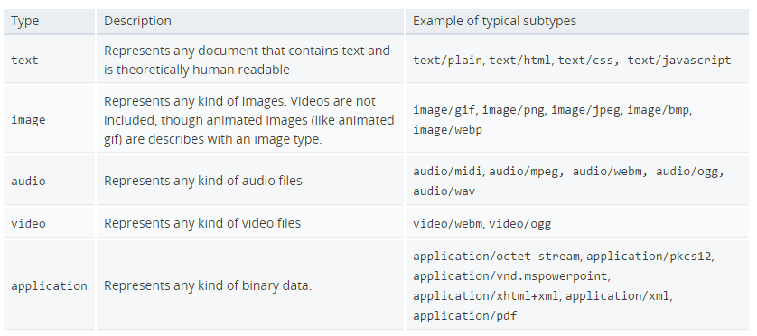
Discrete MIME types
Discrete types indicates the category of the document
For text documents without specific subtype, text/plain should be used. Similarly for binary documents without specific or known subtype, application/octet-stream should be used.

Slide 15
Important MIME types for Web developers
application/octet-stream
This is the default value for a binary files. As it really means unknown binary file, browsers usually don't automatically execute it, or even ask if it should be executed. They treat it as if the Content-Disposition header was set with the value attachment and propose a 'Save As' file.
text/plain
This is the default value for textual files. Even if it really means unknown textual file, browsers assume they can display it.
text/css
Any CSS style files that have to be interpreted as such in a Web page must be of the text/css files. Often servers don’t recognized files with the .css suffix as CSS files and send them with text/plain or application/octet-stream MIME type: in these cases, they won't be recognized as CSS files by most browsers and will be silently ignored. Special attention has to be paid to serve CSS files with the correct type.
text/html
All HTML content should be served with this type. Alternative MIME types for XHTML, like application/xml+html, are mostly useless nowadays (HTML5 unified these formats).
Notes:
Note that text/plain doesn't means any kind of textual data. if browsers expect a specific kind of textual data, they will likely not consider it a match. Specifically if they download a text/plain file from a <link> element declaring a CSS files, they will not recognize it as a valid CSS files if presented with text/plain. The CSS mime type text/css must be used.

Slide 16
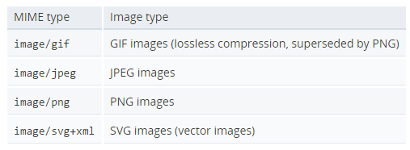
Important MIME types for Web developers
Images types
Only a handful of image types are widely recognized and are considered Web safe, ready for use in a Web page:
Notes:
There is discussion to add WebP (image/webp) to this list, but as each new image type will increase the size of a codebase, this may introduce new security problems, so browser vendors are cautious in accepting it.
Other kinds of images can be found in Web documents. For example, many browsers support icon image types for favicons or similar. In particular, ICO images are supported in this context with the image/x-icon MIME type.

Slide 17
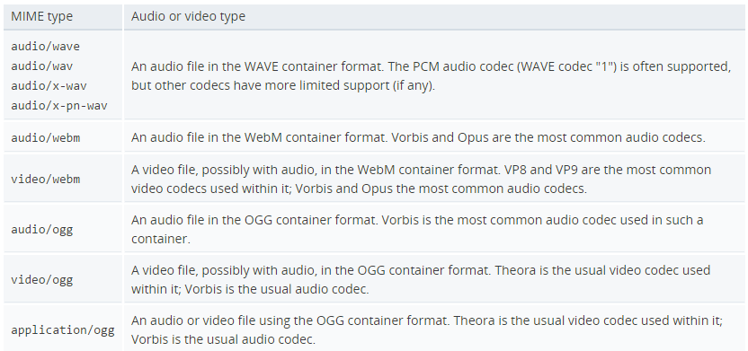
Important MIME types for Web developers
Audio and video types
Like images, HTML doesn't define a set of supported types to use with the <audio> and<video> elements, so only a relatively small group of them can be used on the Web. The Media formats supported by the HTML audio and video elements explains both the codecs and container formats which can be used. The MIME type of such files mostly represent the container formats and the most common ones in a Web context are:

Slide 18
Multipart MIME types
Multipart types indicates a category of document that are broken in distinct parts, often with different MIME types. It is a way to represent a composite document.
With the exception of multipart/form-data, that are used in relation of HTML Forms and POST method, and multipart/byteranges that are used in conjunction with 206 Partial Content status message to send only a subset of a whole document, HTTP doesn't handle multipart documents in a specific way: the message is simply transmitted to the browser (which will likely propose a Save As window, not knowing how display the document inline.)
multipart/form-data
multipart/byteranges

Slide 19
Important MIME types for Web developers
<form action="http://localhost:8000/" method="post" enctype="multipart/form-data">
<input type="text" name="myTextField">
<input type="checkbox" name="myCheckBox">Check</input>
<input type="file" name="myFile">
<button>Send the file</button>
</form>
multipart/form-data
The multipart/form-data type can be used when sending the content of a completed HTML Form from the browser to the server. As a multipart document formal, it consists of different parts, delimited by a boundary (a string starting with a double dash '--'). Each part is an entity by itself, with its own HTTP headers, Content-Disposition, and Content-Type for file uploading fields, and the most common (Content-Length is ignored as the boundary line is used as the delimiter).
POST / HTTP/1.1
Host: localhost:8000
User-Agent: Mozilla/5.0 (Macintosh; Intel Mac OS X 10.9; rv:50.0) Gecko/20100101 Firefox/50.0
Accept: text/html,application/xhtml+xml,application/xml;q=0.9,*/ *;q=0.8
Accept-Language: en-US,en;q=0.5
Accept-Encoding: gzip, deflate
Connection: keep-alive
Upgrade-Insecure-Requests: 1
Content-Type: multipart/form-data; boundary=-8721656041911415653955004498
Content-Length: 465
-8721656041911415653955004498
Content-Disposition: form-data; name="myTextField"
Test
-8721656041911415653955004498
Content-Disposition: form-data; name="myCheckBox"
on
-8721656041911415653955004498
Content-Disposition: form-data; name="myFile"; filename="test.txt"
Content-Type: text/plain
Simple file.
-8721656041911415653955004498--

Slide 20
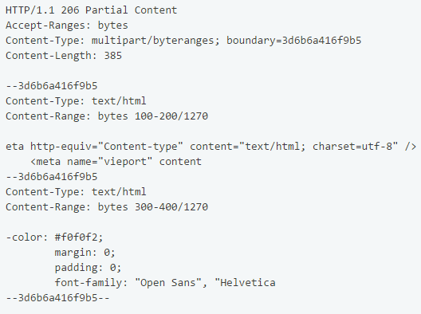
Important MIME types for Web developers
multipart/byteranges
The multipart/byteranges MIME type is used in the context of sending partial responses back to the browser. When the 206 Partial Content status code is sent, this MIME type is used to indicate that the document is composed of several parts, one for each of the requested range. Like other multipart types, the Content-Type uses the boundary directive to define the boundary string. Each of the different parts have a Content-Type header with the actual type of the document and a Content-Range with the range they represent.

Slide 21
Importance of setting the correct MIME type
Most web servers send unknown-type resources using the default application/octet-stream MIME type.
For security reasons, most browsers do not allow setting a custom default action for such resources, forcing the user to store it to disk to use it.
Some commonly seen incorrect server configurations happen with the following file types:
RAR-encoded files. In this case, the ideal would be to set the true type of the encoded files; this is often not possible (as it may not be known to the server and these files may contain several resources of different types). In this case, configuring the server to send the application/x-rar-compressed MIME type, users will not have defined a useful default action for them.
Audio and video files. Only resources with the correct MIME Type will be recognized and played in <video> or <audio> elements.
Proprietary file types. Pay particular attention when serving a proprietary file type. Avoid using application/octet-stream as special handling will not be possible: most browsers do not allow defining a default behavior (like "Opening in Word") for this generic MIME type.

Slide 22
References
https://developer.mozilla.org/en-US/docs/Web/HTTP/Basics_of_HTTP/Identifying_resources_on_the_Web

